Slide 1

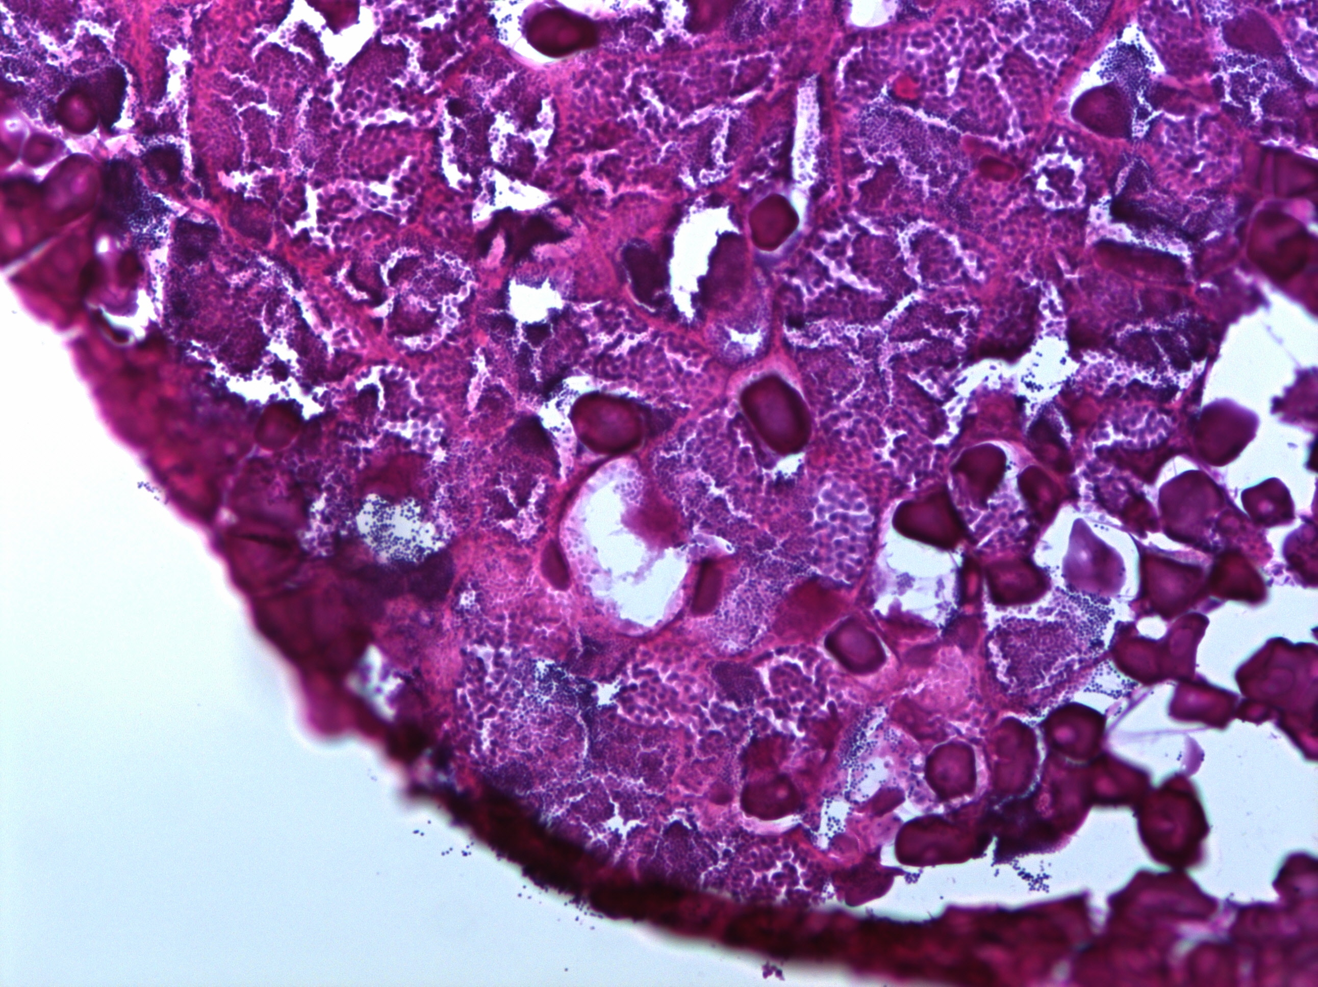
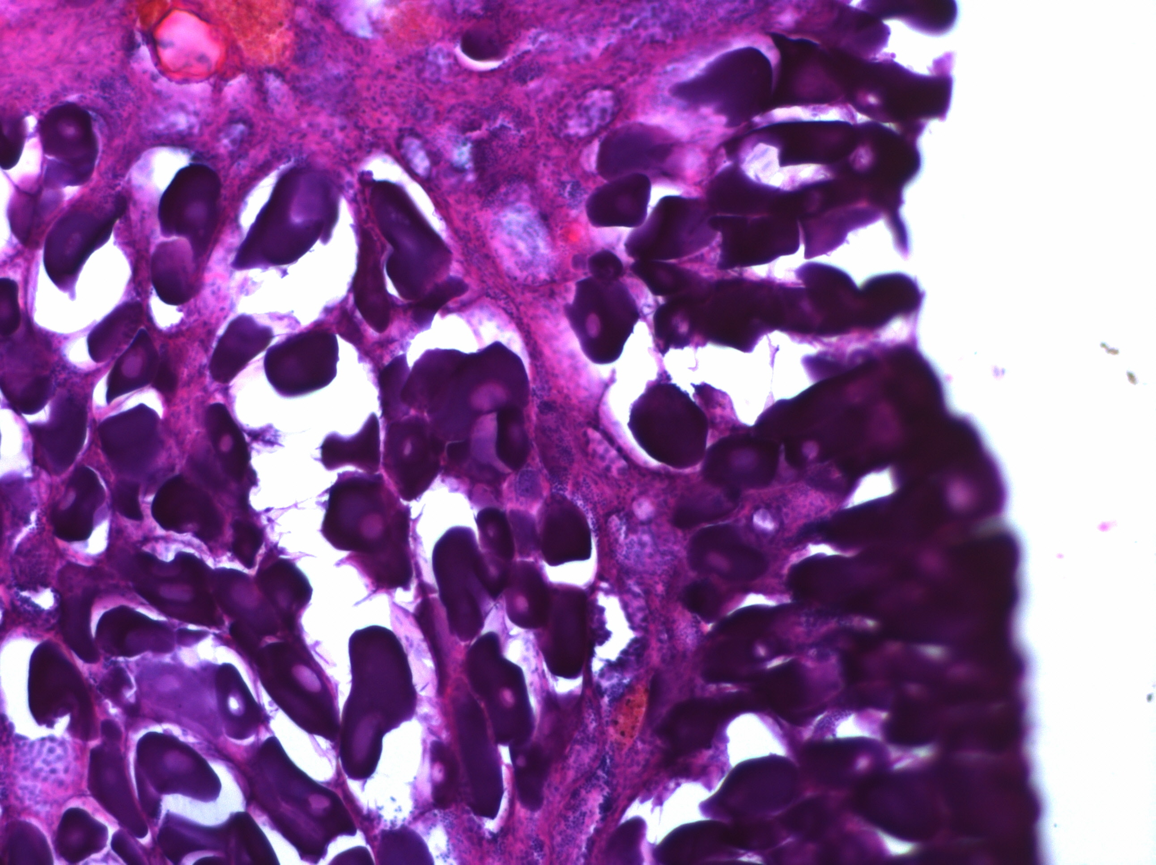
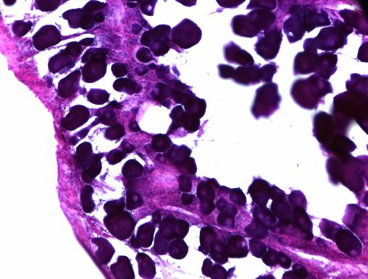
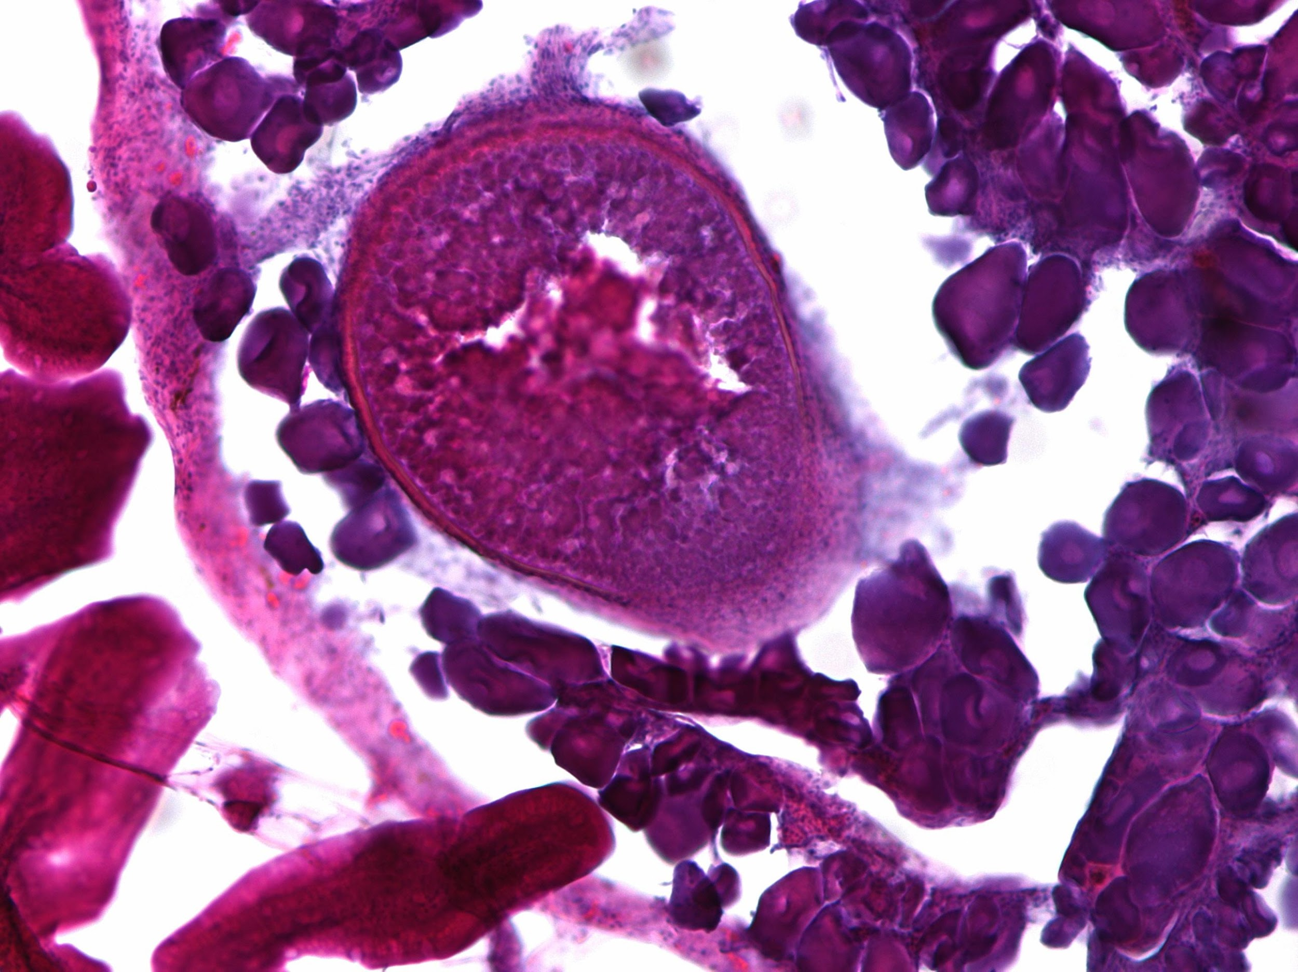
a
Parameter
Max
11KT
E2
Percent Testicular
Vitellogenesis
Body Mass
Neurogenesis
Min
Aggression
♂
I
LI
♀
Parental Care
♂
IP
LIP
♂
Sex Change Progression
b
c
d
Male
800
ab
bc
bc
a
ab
c
ab
abc
80%
d
b
ab
a
c
cd
600
60%
Testicular %
Parental Behaviors
40%
400
7.64x
7.64x
7.64x
7.64x
7.64x
7.64x
7.64x
7.64x
7.64x
7.64x
7.64x
7.64x
7.64x
7.64x
7.64x
7.64x
7.64x
7.64x
7.64x
7.64x
7.64x
7.64x
7.64x
7.64x
7.64x
7.64x
7.64x
7.64x
7.64x
7.64x
7.64x
2.21x
7.64x
Intermediate
2.21x
2.21x
2.21x
2.21x
2.21x
2.21x
2.21x
2.21x
2.21x
2.21x
2.21x
2.21x
2.21x
2.21x
2.21x
2.21x
2.21x
2.21x
2.21x
2.21x
2.21x
2.21x
2.21x
2.21x
2.21x
2.21x
2.21x
2.21x
2.21x
2.21x
2.21x
3.88x
3.88x
3.88x
3.88x
3.88x
3.88x
3.88x
3.88x
3.88x
3.88x
3.88x
3.88x
3.88x
3.88x
3.88x
3.88x
3.88x
3.88x
3.88x
3.88x
3.88x
3.88x
3.88x
3.88x
3.88x
3.88x
3.88x
3.88x
3.88x
3.88x
3.88x
200
3.88x
11.08x
20%
11.08x
11.08x
11.08x
11.08x
11.08x
11.08x
11.08x
11.08x
11.08x
11.08x
11.08x
11.08x
11.08x
11.08x
11.08x
11.08x
11.08x
11.08x
11.08x
11.08x
11.08x
11.08x
11.08x
11.08x
11.08x
11.08x
11.08x
11.08x
11.08x
11.08x
11.08x
0
0%
F
M
I
IP
LI
LIP
NF
NM
100%
M
I
IP
LI
LIP
NM
ab
c
bc
a
abc
bc
a
abc
a
c
c
b
b
ab
600
Phase
Phase
80%
1.84x
1.84x
1.84x
1.84x
1.84x
1.84x
1.84x
1.84x
1.84x
1.84x
1.84x
1.84x
1.84x
1.84x
1.84x
1.84x
1.84x
1.84x
1.84x
1.84x
1.84x
1.84x
1.84x
1.84x
1.84x
1.84x
1.84x
1.84x
1.84x
1.84x
1.84x
1.69x
1.84x
1.69x
1.69x
1.69x
1.69x
1.69x
1.69x
1.69x
1.69x
1.69x
1.69x
1.69x
1.69x
1.69x
1.69x
1.69x
1.69x
1.69x
1.69x
1.69x
1.69x
1.69x
1.69x
1.69x
1.69x
1.69x
1.69x
1.69x
1.69x
1.69x
1.69x
400
1.69x
Ovarian %
2.14x
60%
2.14x
2.14x
2.14x
2.14x
2.14x
2.14x
2.14x
2.14x
2.14x
2.14x
2.14x
2.14x
2.14x
2.14x
2.14x
2.14x
2.14x
2.14x
2.14x
2.14x
2.14x
2.14x
2.14x
2.14x
2.14x
2.14x
2.14x
2.14x
2.14x
2.14x
Time in nest (s)
2.14x
Late Intermediate
10.67x
10.67x
10.67x
10.67x
10.67x
10.67x
10.67x
10.67x
10.67x
10.67x
10.67x
10.67x
10.67x
10.67x
10.67x
10.67x
10.67x
10.67x
10.67x
10.67x
10.67x
10.67x
10.67x
10.67x
10.67x
10.67x
10.67x
10.67x
10.67x
10.67x
10.67x
200
10.67x
40%
0
20%
3.5
F
M
I
IP
LI
LIP
NF
NM
c
ab
a
c
abc
bc
a
d
cd
bc
a
bcd
ab
bcd
Phase
Phase
0.3
3.0
Female
2.5
1.11x
0.0
Corrected Volume
1.35x
1.35x
1.35x
1.35x
1.35x
1.35x
1.35x
1.35x
1.35x
1.35x
1.35x
1.35x
1.35x
1.35x
1.35x
1.35x
1.35x
1.35x
1.35x
1.35x
1.35x
1.35x
1.35x
1.35x
1.35x
1.35x
1.35x
1.35x
1.35x
1.35x
1.35x
Log10 11KT (pg/ml)
1.85x
1.35x
1.85x
1.85x
1.85x
1.85x
1.85x
1.85x
1.85x
1.85x
1.85x
1.85x
1.85x
1.85x
1.85x
1.85x
1.85x
1.85x
1.85x
1.85x
1.85x
1.85x
1.85x
1.85x
1.85x
1.85x
1.85x
1.85x
1.85x
1.85x
1.85x
1.85x
1.85x
1.69x
1.69x
1.69x
1.69x
1.69x
1.69x
1.69x
1.69x
1.69x
1.69x
1.69x
1.69x
1.69x
1.69x
1.69x
1.69x
1.69x
1.69x
1.69x
1.69x
1.69x
1.69x
1.69x
1.69x
1.69x
1.69x
1.69x
1.69x
1.69x
1.69x
1.69x
2.0
1.69x
-0.3
1.5
-0.6
F
M
I
IP
LI
LIP
NF
NM
M
I
IP
LI
LIP
NM
Phase
Phase

Slide 2
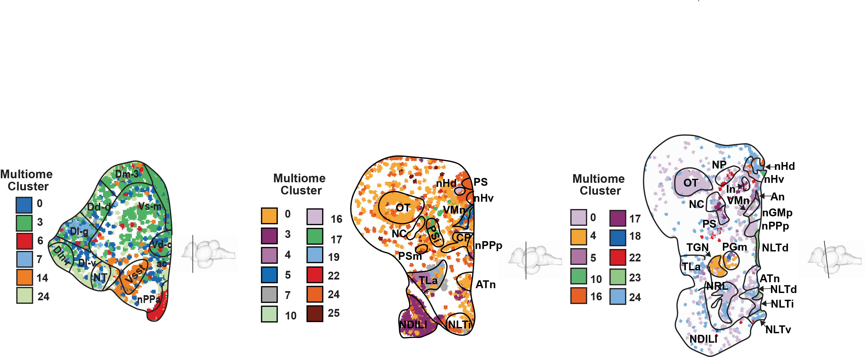
a
13
b
Multiome → Regions
25
24
23
11
22
12
26
21
4
19
1
15
18
25
22
17
17
7
16
Multiome Cluster
24
14
9
12
3
10
0
8
8
2
6
18
7
21
6
5
5
14
4
3
1
UMAP_2
20
16
0
ln
Vi
ac
Dc
TL
Vc
Vp
Vv
Dd
Dp
NT
PS
CP
Gn
NP
OT
Illn
CM
NC
ON
PSi
TLa
ATn
Dl-g
nHv
nTE
TPp
Vsst
nHd
NLT
PGa
PSP
Vd-r
NRL
PGn
TGN
VOT
VMn
Dc-2
NLTi
Vd-c
Dd-v
PSm
Dd-d
Dln-r
PGm
19
Dl-v2
Vs-m
Dln-c
NLTv
nPPa
Dm-1
Dl-gd
Dm-3
NDILI
NLTd
nPPp
nGMp
NLTm
nPMp
UMAP_1
Dl-v2d
Dm-2r
NDILm
nMMp
0.8
10
23
Region
Proportion of Region
c
0.6
0.4
0.2
0
d
1_RGC
e
6_NPO
g
1.00
First Changes
Glutamatergic
25%
p = 0.907
**
0.75
GABAergic
**
***
*
Mixed
20%
p = 0.51
0.50
Glial
10%
Prediction
15%
0.25
Last Changes
% of Cells
% of Neurons
10%
5%
0.00
5%
5_Di
2_OL
12_Vp
8_PGa
18_PG
17_PSi
4_TGN
10_nHv
11_MG
6_NPO
1_RGC
16_nHd
0_Mixed
3_GABA
0%
M
I
LI
NF
F
0%
19_GABA
f
Phase
M
I
LI
NF
F
Classification
Phase
50
Early Downregulated
40
Early Upregulated
30
Late Downregulated
DEGs
Late Upregulated
20
Progressively Downregulated
10
Progressively Upregulated
0
Transiently Downregulated
2_OL
5_Di
8_PGa
12_Vp
15_EC
18_PG
22_PS
1_RGC
4_TGN
6_NPO
11_MG
17_PSi
0_Mixed
7_GLUT
10_nHv
14_Vsst
16_nHd
23_NLTi
Transiently Upregulated
3_GABA
9_Mixed
13_OPC
20_Leuko
24_Mixed
26_DG
19_GABA
21_GABA
25_GABA

Slide 3
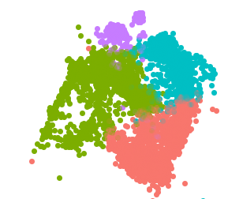
a
cyp19a1b
b
1_RGC
1_gfap
p = 0.283
1_shha
3
***
***
Expression
1_NP
2
1_NSC
1
UMAP_2
UMAP_2
UMAP_1
M
I
LI
NF
F
UMAP_1
1_NP
Phase
p.adjust
c
d
neuron differentiation
1.00
c
a
b
b
axon guidance
0.0005
0.75
Wnt signaling pathway
0.0010
Negative regulation of forebrain development
0.0015
CytoTRACE
canonical Wnt signaling
0.50
central nervous system development
0.25
cell fate commitment pathway
Count
canonical Wnt signaling pathway
5
1_NP
frizzled binding
10
1_shha
1_NSC
1_gfap
negative regulation of axon extension involved in axon guidance
Subcluster
15
0.02
0.04
0.06
0.08
0.10
GeneRatio
e
1_NSC
f
1_NP
g
neuron differentiation
1_NP
Some ATAC?
80%
p = 0.356
**
0.07
60%
**
*
75%
*
***
**
p = 0.51
**
% of 1_RGC
0.06
40%
50%
AUC Score
20%
25%
0.05
0%
M
I
LI
NF
F
0%
M
I
LI
NF
F
M
I
LI
NF
F
Phase
Phase
Phase
Spatial? I guess show that 1_NP and 1_NSC exist near nPPa
Do we even need to fill up this figure

Slide 4
a
6_NPO
b
6_NPO DEGs
p.adjust
GPCR signaling pathway
0.01
GPCR receptor activity
0.02
positive regulation of transcription by RNA pol III
0.03
protein tyrosine phosphatase activity
Count
learning or memory
2
non-membrane spanning protein tyrosine phosphatase activity
3
protein tyrosine phosphatase activity, metal-dependent
4
perineuronal net
5
UMAP_2
estrogen response element binding
6
UMAP_1
peptidyl-tyrosine dephosphorylation
7
0 .05
0.10
0.15
c
6_NPO DEGs
Classification
GeneRatio
ldlrp8-like
Early Upregulated
Some ATAC?
Some ATAC?
chgb
cd87-like
picalm
grm5a
Transiently Upregulated
pgr
§
ptprz1a
†
sdc2
Late Downregulated
rgs9-like
frmpd4-like
shisal2a-like
wdfy2
Late Upregulated
†
dse-like
gpcr22-like
cntn4
†
Early Downregulated
ptprfa
ca16b
nxph1-like
†
Transiently Downregulated
rgs5b
capn1-like
znf385C-like
Type
tenm3-like
gsta1-like
† ECM / Cell Adhesion
§ Gonadotroph Associated
pgr-like
§
kcn4-like
drd3
§
LOC111575683
neurl1-like
pim3
ECM DEG+
ECM DEG-
6_NPO
mxi1
f
g
lmbrd2b-like
***
sinhcaf-like
Z-Score
camk2g2
1.0
0.8
LOC111565841
2
*
p = 0.123
pde1cb
p = 0.131
gabra3
stxbp6
0.7
ell
1
0.8
*
p = 0.25
**
§
nmbr
p = 0.714
p = 0.874
p = 0.203
npy7r
§
slc25a1-like
myo1c-like
CytoTRACE
0.6
nudt4a
0
0.6
kcnd3-like
bcan
†
ca10-like
0.5
§
tacr3a
-1
cntnap4-like
†
0.4
nova2
pcdh10b
†
0.4
LOC118470193
gfra3
M
I
F
-2
0.2
M
I
LI
NF
F
M
I
LI
NF
F
M
I
LI
NF
F
Phase
i
brain development
j
axon guidance receptor activity
More spatial?
Again, do we need to fill up this fig
0.12
p = 0.785
0.200
p = 0.405
0.10
**
***
**
*
AUC Score
0.175
0.08
0.150
0.125
M
I
LI
NF
F
M
I
LI
NF
F
Phase

Slide 5
a
npy7r
b
drd3
drd3+
drd3-
0.20
***
0.20
**
1.5
p = 0.661
**
p = 0.586
**
p = 0.906
*
0.15
p = 0.101
0.15
1.0
p = 0.541
p = 0.33
p = 0.711
**
Expression
CytoTRACE
0.10
0.10
Expression
0.5
0.05
0.05
0.0
0.00
0.00
M
I
LI
NF
F
M
I
LI
NF
F
M
I
LI
NF
F
M
I
LI
NF
F
tacr3a+
tacr3a-
tacr3a
d
gnrh1
c
**
1.25
p = 0.077
*
0.3
Main effect p = 0.151
0.4
p = 0.074
***
1.00
p = 0.644
*
Expression
p = 0.939
p = 0.568
p = 0.794
0.75
0.2
0.2
CytoTRACE
Expression
0.50
0.1
0.0
0.0
M
I
LI
NF
F
M
I
LI
NF
F
M
I
LI
NF
F
M
I
LI
NF
F
e
cckb+
cckb+
cckb-
12%
gnrh1+
*
p = 0.089
Main effect p = 0.061
30%
p = 0.629
*
1.0
*
p = 0.053
8%
0.8
p = 0.657
**
p = 0.755
*
% 6_NPO
20%
% 6_NPO
CytoTRACE
4%
10%
0.6
0.4
0%
0%
M
I
LI
NF
F
M
I
LI
NF
F
M
I
LI
NF
F
M
I
LI
NF
F
Phase
f
Phase
Parameter
Max
Hypothesized
LH
FSH
11KT
E2, P4 and cckb
cyp19a1b
gnrh1
npy7r
Min
♂
I
LI
♀
tacr3a
♂
IP
drd3
LIP
♂
Sex Change Progression

Slide 6
a
b
16
d
ab
c
a
c
ab
bcd
abc
d
ab
c
a
cd
ab
bcd
abc
12
8
Mass (g)
Length (cm)
8
1.44x
1.44x
1.44x
1.44x
1.44x
1.44x
1.44x
1.44x
1.44x
1.44x
1.44x
1.44x
1.44x
1.44x
1.44x
1.44x
1.44x
1.44x
1.44x
1.44x
1.44x
1.44x
1.44x
1.44x
1.44x
1.44x
1.44x
1.44x
1.44x
1.44x
1.44x
1.44x
1.28x
1.28x
1.28x
1.28x
1.28x
1.28x
1.28x
1.28x
1.28x
1.28x
1.28x
1.28x
1.28x
1.28x
1.28x
1.28x
1.28x
1.28x
1.28x
1.28x
1.28x
1.28x
1.28x
1.28x
1.28x
1.28x
1.28x
1.28x
1.28x
1.28x
1.28x
6
1.28x
1.28x
1.28x
1.28x
1.28x
1.28x
1.28x
1.28x
1.28x
1.28x
1.28x
1.28x
1.28x
1.28x
1.28x
1.28x
1.28x
1.28x
1.28x
1.28x
1.28x
1.28x
1.28x
1.28x
1.28x
1.28x
1.28x
1.28x
1.28x
1.28x
1.28x
1.28x
3.12x
1.28x
3.12x
3.12x
3.12x
3.12x
3.12x
3.12x
3.12x
3.12x
3.12x
3.12x
3.12x
3.12x
3.12x
3.12x
3.12x
3.12x
3.12x
3.12x
3.12x
3.12x
3.12x
3.12x
3.12x
3.12x
3.12x
3.12x
3.12x
3.12x
3.12x
3.12x
3.12x
1.31x
1.31x
1.31x
1.31x
1.31x
1.31x
1.31x
1.31x
1.31x
1.31x
1.31x
1.31x
1.31x
1.31x
1.31x
1.31x
1.31x
1.31x
1.31x
1.31x
1.31x
1.31x
1.31x
1.31x
1.31x
1.31x
1.31x
1.31x
1.31x
1.31x
1.31x
2.52x
1.31x
2.52x
2.52x
2.52x
2.52x
2.52x
2.52x
2.52x
2.52x
2.52x
2.52x
2.52x
2.52x
2.52x
2.52x
2.52x
2.52x
2.52x
2.52x
2.52x
2.52x
2.52x
2.52x
2.52x
2.52x
2.52x
2.52x
2.52x
2.52x
2.52x
2.52x
2.19x
2.52x
2.19x
2.19x
2.19x
2.19x
2.19x
2.19x
2.19x
2.19x
2.19x
2.19x
2.19x
2.19x
2.19x
2.19x
2.19x
2.19x
2.19x
2.19x
2.19x
2.19x
2.19x
2.19x
2.19x
2.19x
2.19x
2.19x
2.19x
2.19x
2.19x
2.19x
4
2.33x
2.19x
2.33x
2.33x
2.33x
2.33x
2.33x
2.33x
2.33x
2.33x
2.33x
2.33x
2.33x
2.33x
2.33x
2.33x
2.33x
2.33x
2.33x
2.33x
2.33x
2.33x
2.33x
2.33x
2.33x
2.33x
2.33x
2.33x
2.33x
2.33x
2.33x
2.33x
2.33x
4
F
M
I
IP
LI
LIP
NF
NM
F
M
I
IP
LI
LIP
NF
NM
Phase
Phase
Notes:
Supplementary physiology

Slide 7
a
Cells
0_Mixed
1_RGC
2_OL
3_GABA
4_TGN
7_GLUT
***
25%
p = 0.907
***
12.5%
**
**
p = 0.799
***
30%
p = 0.779
***
20%
**
***
20%
***
***
10.0%
p = 0.107
p = 0.211
10%
**
9%
*
***
20%
15%
15%
7.5%
6%
10%
10%
10%
5.0%
5%
3%
5%
5%
2.5%
0%
0%
0%
0%
0%
0.0%
M
I
LI
NF
M
I
LI
F
M
I
LI
NF
F
NF
F
M
I
LI
NF
M
I
LI
F
NF
F
M
I
LI
NF
% of Cells
F
9_Mixed
11_MG
12_Vp
19_GABA
22_PS
24_Mixed
10.0%
***
**
6%
p = 0.094
4%
p = 0.848
**
**
7.5%
p = 0.158
**
6%
*
p = 0.347
4%
**
p = 0.235
3%
*
**
2%
p = 0.634
**
2%
p = 0.389
***
5.0%
4%
2%
2%
1%
1%
2.5%
2%
1%
0.0%
M
0%
0%
0%
0%
0%
I
LI
NF
F
M
I
LI
NF
F
M
I
LI
NF
F
M
I
LI
NF
F
M
I
LI
NF
F
M
I
LI
NF
F
Phase
Neurons
b
0_Mixed
6_NPO
4_TGN
7_GLUT
9_Mixed
14Vsst
30%
*
**
p = 0.27
***
10.0%
***
6%
*
*
***
7.5%
p = 0.51
*
10%
*
**
9%
p = 0.096
***
7.5%
p = 0.439
**
5%
**
p = 0.327
20%
5.0%
6%
4%
5%
5.0%
3%
10%
2.5%
3%
2.5%
2%
0.0%
0%
0%
0.0%
1%
0%
M
I
LI
0%
NF
F
M
I
LI
NF
F
M
I
LI
NF
F
M
I
LI
NF
M
I
LI
F
M
I
LI
NF
F
NF
17_PSi
F
18_PG
19_GABA
22_PS
24_Mixed
% of Neurons
5%
**
p = 0.272
5%
*
**
4%
p = 0.515
*
**
4%
p = 0.086
4%
p = 0.715
3%
p = 0.053
**
2%
p = 0.378
**
2%
p = 0.229
***
3%
3%
2%
2%
2%
1%
1%
1%
1%
1%
0%
M
I
LI
NF
F
0%
M
I
LI
NF
F
0%
M
I
LI
NF
F
0%
M
I
LI
NF
F
0%
M
I
LI
NF
F
Phase
Notes:
Supplemental cell populations

Slide 8
Notes:
Supplemental correlations with visium clusters

Slide 9
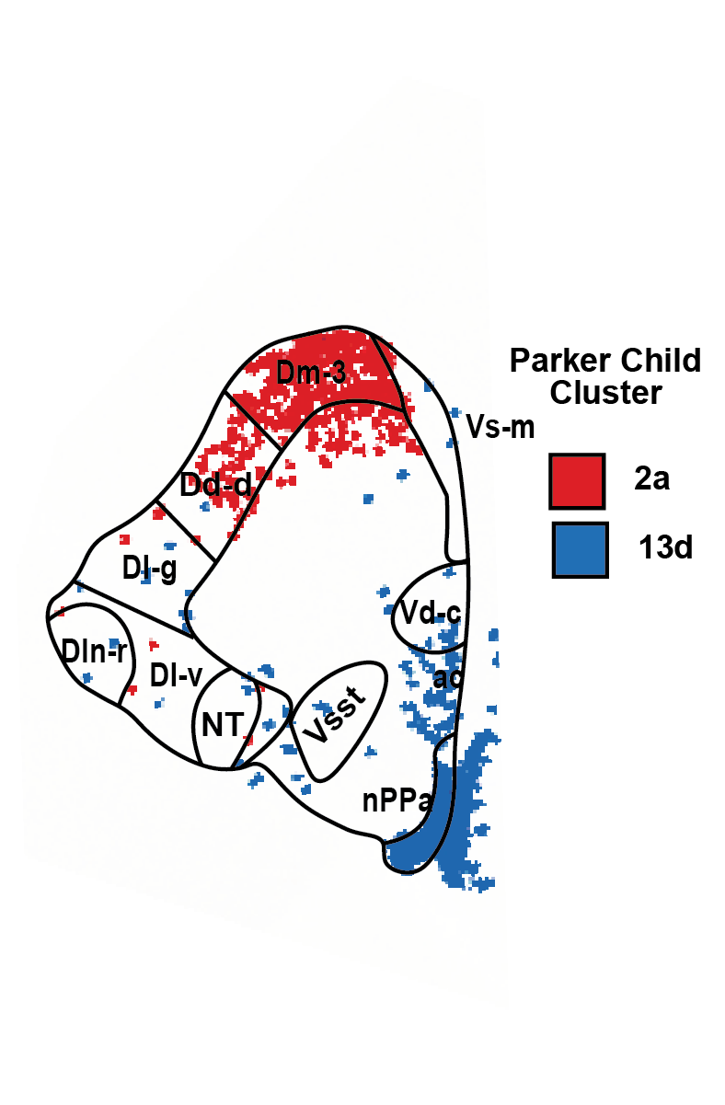
Notes:
Supplemental parker -> region

Slide 10
1_RGCs DEGs
Classification
cyp19a1b
Late Upregulated
nlrc3-like
mical2b
lrrc49-like
Late Downregulated
lhfpl3
†
nkx2.2a
gjc1-like
Transiently Upregulated
LOC129348729
LOC129348282
pcnx4
Transiently Downregulated
†
sox6
rpl24
kcnh6a
Early Upregulated
tap2t
pp1r37-like
Early Downregulated
†
foxp2
immp2l
arhgef28-like
Progressively Downregulated
fmnl1-like
zgc:113263
sema3ab
LOC111583974
il1rapl1a
fgfbp3
plce1
Z-Score
Type
slc44a2
†
skida1
dab1a
2
ccdc85cb
†
tmed4
Transcription Factor
†
pknox2-like
§
†
COUPTFII-like
1
Chromatin Modifier
glceb
LOC111564869
jam3b-like
tmtc2b
0
†
gli1
§
dnmt3bb.1
cog5
§
brd3-like
-1
†
znf710b
lrch4
†
dbx1b-like
-2
ssbp4
M
I
F
Phase
Notes:
Supp RGC Txn Factors

Slide 11
a
1_NSC
p.adjust
d
dendrite
vegfab
axon
1e-07
fgfr3
postsynaptic membrane
2e-07
fgfr2
postsynaptic density
3e-07
shha
postsynaptic density membrane
lmx1.2-like
dendritic spine
Count
modulation of chemical synaptic transmission
50
foxg1a
proton transmembrane transport
sox2
synaptic membrane adhesion
100
pax6b
Ionotropic glutamate receptor signaling pathway
150
sema4gb
0.02
0.04
0.06
slc4a4a
GeneRatio
p.adjust
1_gfap
slc6a1b
b
slc6a11b
collagen-containing
0.02
angpt1
extracellular matrix
0.03
cyp19a1b
axon guidance
gja1b
Count
gfap
dopaminergic neuron
4
Percent
Expressed
1_NP
1_shh
differentiation
6
1_NSC
1_gfap
25
Average Expression
somite development
8
50
10
75
1.0
0.5
0.0
-0.5
-1.0
0.025
0.050
0.075
0.100
12
GeneRatio
c
1_shh
p.adjust
axon guidance
0.005
0.010
negative chemotaxis
0.015
Count
0.020
anatomical structure
4
formation involved in
6
morphogenesis
8
0.04
0.06
0.08
0.10
0.12
0.14
10
GeneRatio
Notes:
Supp RGC GO of marker genes

Slide 12
a
cckb
nmbr
pgr
pgr-like
Main effect p = 0.291
***
0.5
*
**
0.75
1.0
***
0.4
*
***
0.4
p = 0.62
***
0.8
p = 0.935
0.3
0.3
Expression
0.50
0.6
0.2
0.2
0.25
0.4
0.1
0.1
0.2
0.0
M
I
LI
NF
F
M
I
LI
NF
F
M
I
LI
NF
F
M
I
LI
NF
F
b
npy7r+
nmbr+
pgr+
pgr-like+
8%
**
50%
**
25%
**
30%
***
6%
p = 0.158
p = 0.114
40%
p = 0.487
*
20%
p = 0.41
***
p = 0.556
**
30%
15%
20%
% 6_NPO
4%
20%
10%
10%
2%
10%
5%
0%
0%
0%
0%
M
I
LI
NF
F
M
I
LI
NF
F
M
I
LI
NF
F
M
I
LI
NF
F
Phase
c
npy7r+
npy7r-
pgr+
pgr-
pos vs neg: p = 0.491
pos vs neg: ***
1.5
p = 0.237
*
1.2
p = 0.831
*
1.0
p = 0.948
p = 0.254
p = 0.605
**
0.9
p = 0.5
p = 0.554
p = 0.62
**
0.5
0.6
0.3
M
I
LI
NF
F
M
I
LI
NF
F
M
I
LI
NF
F
M
I
LI
NF
F
CytoTRACE
pgr-like+
pgr-like-
gnrh1+
gnrh1-
pos vs neg: p = 0.645
pos vs neg: *
p = 0.243
*
p = 0.679
*
1.00
p = 0.591
p = 0.554
p = 0.567
**
0.75
p = 0.107
*
p = 0.757
*
0.75
0.50
0.50
0.25
0.25
M
I
LI
NF
F
M
I
LI
NF
F
0.00
M
I
LI
NF
F
M
I
LI
NF
Phase
F
Notes:
Supplemental gene expression and population of 6 degs

Slide 13
Notes:
Supplemental drawings I will make better and then add H&E and cell projections at some point

